Slide 1

Welcome to Sabbath School
Illustration by Jo Card. Copyright © 2024 General Conference Corporation® of Seventh-day Adventists.

Slide 2

EARLY ARRIVALS
EARLY
ARRIVALS

Slide 3
Welcome to Sabbath School
Illustration by Jo Card. Copyright © 2024 General Conference Corporation® of Seventh-day Adventists.

Slide 4


Alive in Jesus
OPENING ACTIVITIES
Welcome to Sabbath School.
It’s good to see you.
How are you today?
Let’s have some fun
As we learn about God’s love
And follow in His way.
We’re alive in Jesus.
We’re alive in Jesus.
(Repeat above)
"Alive in Jesus" by Rosie Smith, copyright © 2024 General Conference Corporation® of Seventh-day Adventists.

Slide 5
When God Speaks
OPENING ACTIVITIES
When God spoke to the darkness,
“Let there be light,”
It was done and the darkness fled away.
When God spoke to an old man,
“You’ll have a son,”
It was done and the sadness fled away.
(Continued on next slide)

Slide 6
When God Speaks
OPENING ACTIVITIES
When God speaks
A miracle happens.
When God speaks
The light begins to shine.
If God’s word is so powerful
That it can make the universe,
It can remake you too.
(Continued on next slide)

Slide 7
When God Speaks
OPENING ACTIVITIES
When God spoke to a blind man,
“Receive your sight,”
It was done and the darkness fled away.
When God spoke to a dead man,
“Lazarus come forth,”
It was done and the sadness fled away.
(Continued on next slide)

Slide 8
When God Speaks
OPENING ACTIVITIES
When God speaks
A miracle happens.
When God speaks
The light begins to shine.
If God’s word is so powerful
That it can make the universe,
It can remake you too.
(Continued on next slide)

Slide 9
When God Speaks
OPENING ACTIVITIES
For God keeps His word.
Never will He fail.
In every command and every promise
There is power to do what it says,
For all who believe.
So trust and obey.
Oh, trust Him today.
(Continued on next slide)

Slide 10
When God Speaks
OPENING ACTIVITIES
When God speaks
A miracle happens.
When God speaks
The light begins to shine.
If God’s word is so powerful
That it can make the universe,
It can remake you too.
It can remake you too.
Won’t you let Him remake you too?
"When God Speaks" by Braedan Entermann, copyright © 2018 Braedan Entermann. Used by permission.

Slide 11
Sabbath Song
OPENING ACTIVITIES
He made us, He saved us,
He’s coming back to take us home.
(Repeat two times)
Jesus, You are welcome in this place.
Father, You are welcome in this space.
Holy Spirit, fill our hearts with grace.
In this palace of time and space.
(Repeat above)
In this palace of time and space.
"Sabbath Song" by Alexandria and Leighton Heise, copyright © 2020, Alexandria and Leighton Heise. Used by permission.

Slide 12

PRAYER
PRAYER

Slide 13
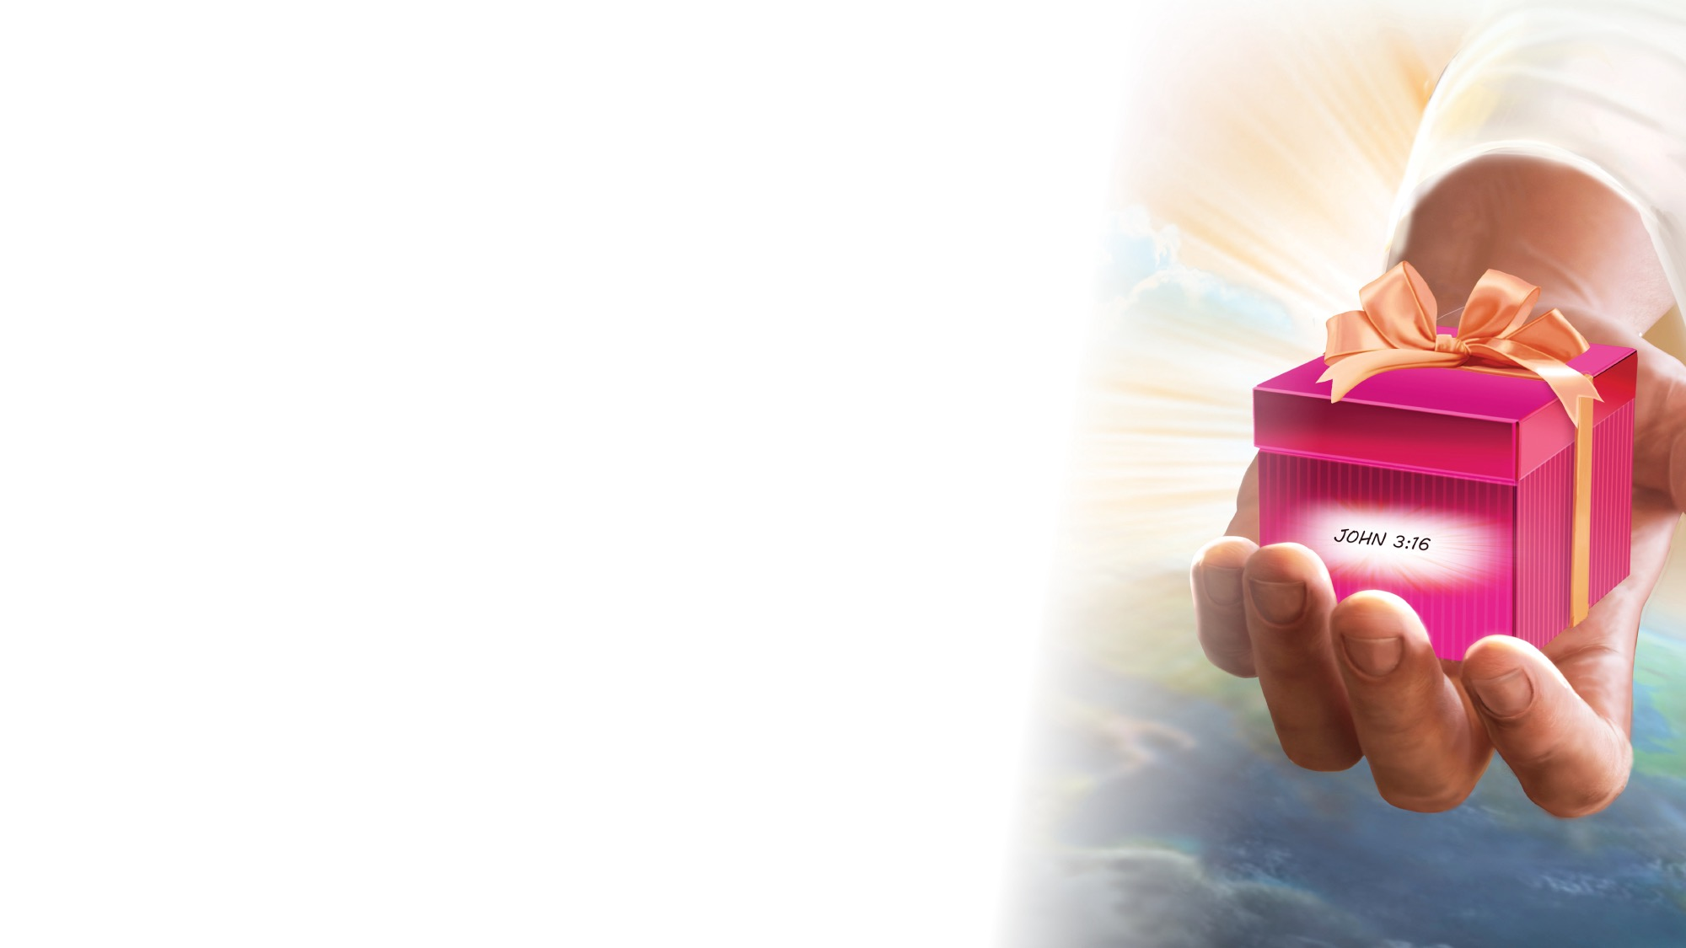
OFFERING

Slide 14

Thank You, Jesus
OPENING ACTIVITIES
Thank you, Jesus
For providing all my needs.
I want to give a little back
Of what you’ve given me.
Please bless our
Sabbath School offering.
May it bring You glory
And help others in need.
(Repeat above)
May it bring You glory
And help others in need.
"Thank You, Jesus" by Rosie Smith, copyright © 2024 General Conference Corporation® of Seventh-day Adventists.

Slide 15
MISSION
FAST FACT &
OFFERING
CHART

Slide 16
Visitor Song
OPENING ACTIVITIES
We have a new friend
With us today.
We have a new friend.
Let’s smile and wave.
We welcome you to Sabbath School.
We’re glad you came.
We welcome you,
And hope to see you again. (x2)
“Visitor Song” by Rosie Smith. Copyright © 2025 General Conference Corporation® of Seventh-day Adventists.

Slide 17
Happy Birthday
OPENING ACTIVITIES
Happy birthday, happy birthday,
Happy birthday to you.
Jesus loves you dear ___________.
Happy birthday to you.
(Repeat above)
“Happy Birthday” by Janet Sage, copyright © 2001 North American Division Corporation of Seventh-day Adventists. From Little Voices Praise Him, #39. Used by permission.

Slide 18

FOCUS
ACTIVITIES

Slide 19
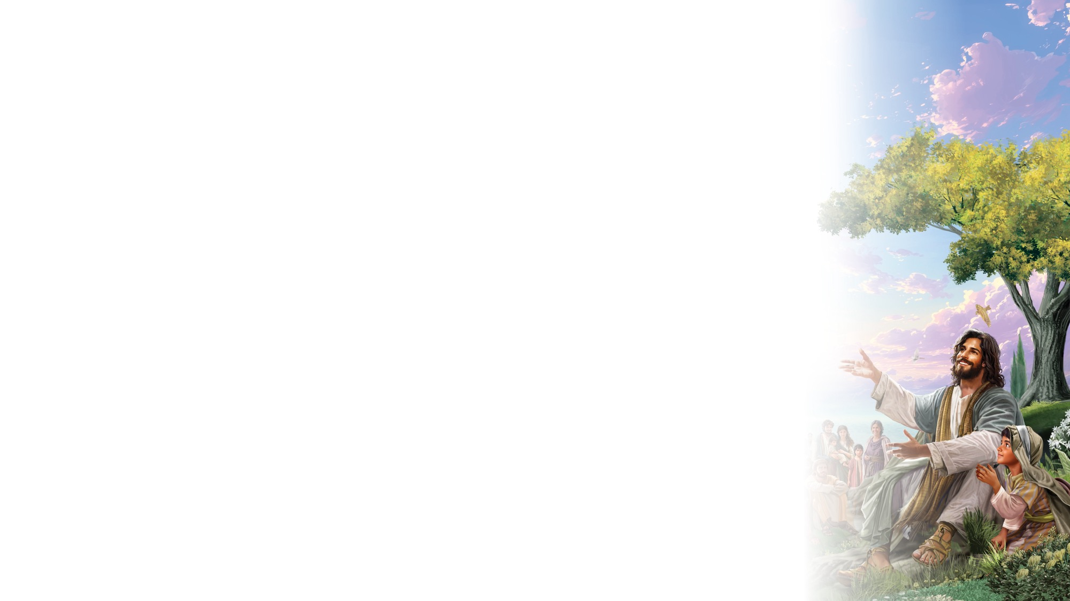
BIG IDEA
Jesus feeds me with His words and with food.

Slide 20

BIBLE
STORY

Slide 21
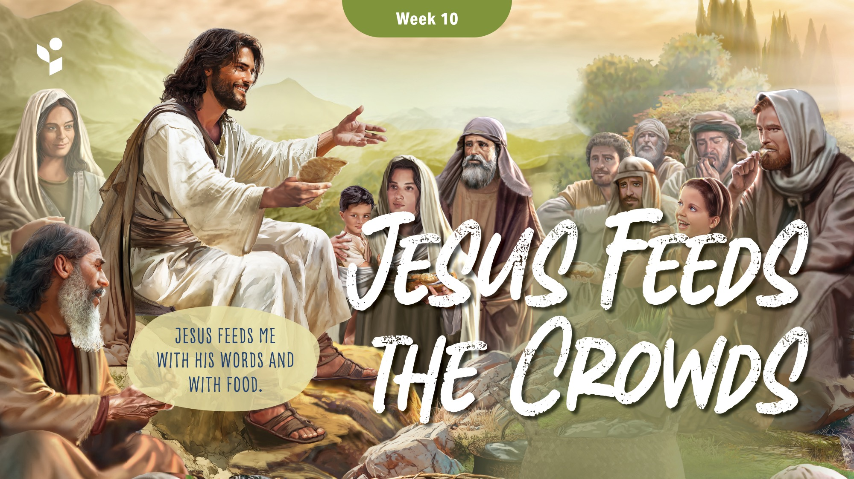

Slide 22
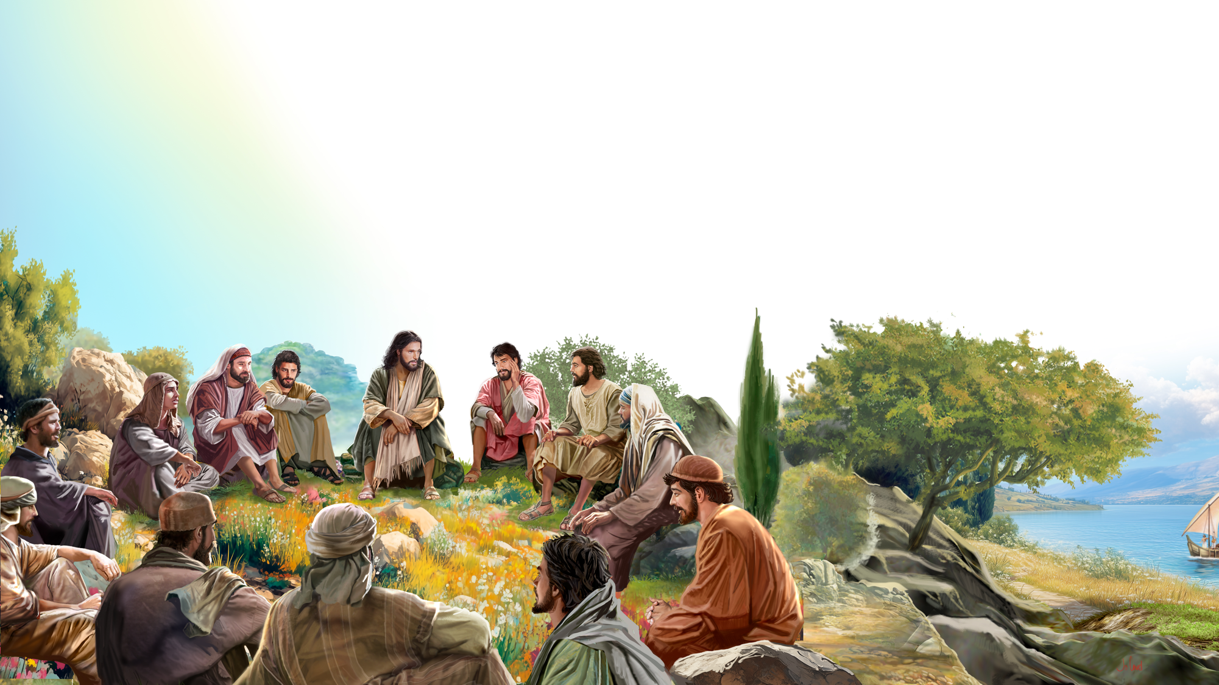
Illustration by Jo Card. Copyright © 2024 General Conference Corporation® of Seventh-day Adventists.

Slide 23
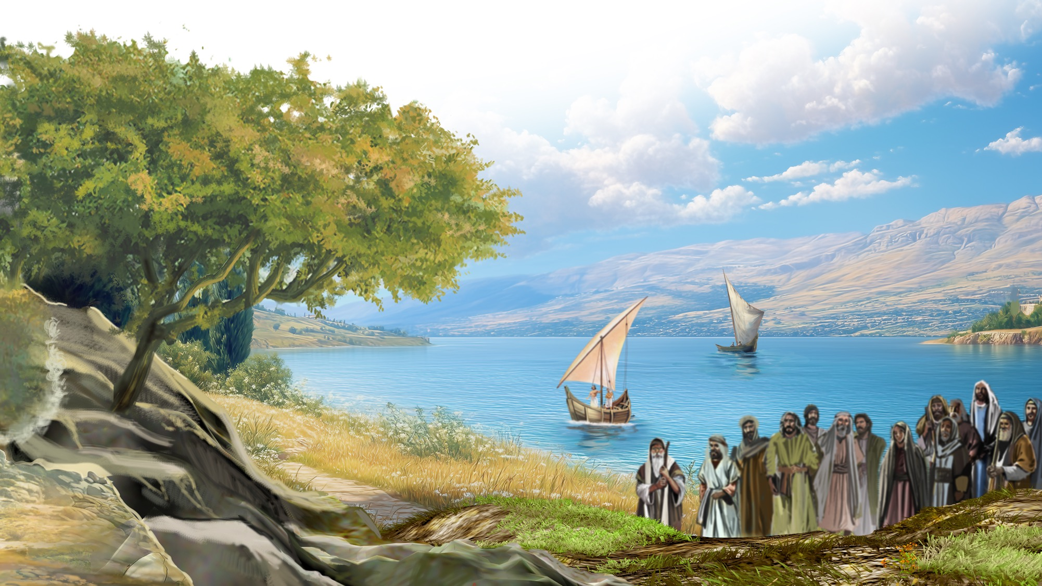
Illustration by Jo Card. Copyright © 2024 General Conference Corporation® of Seventh-day Adventists.

Slide 24
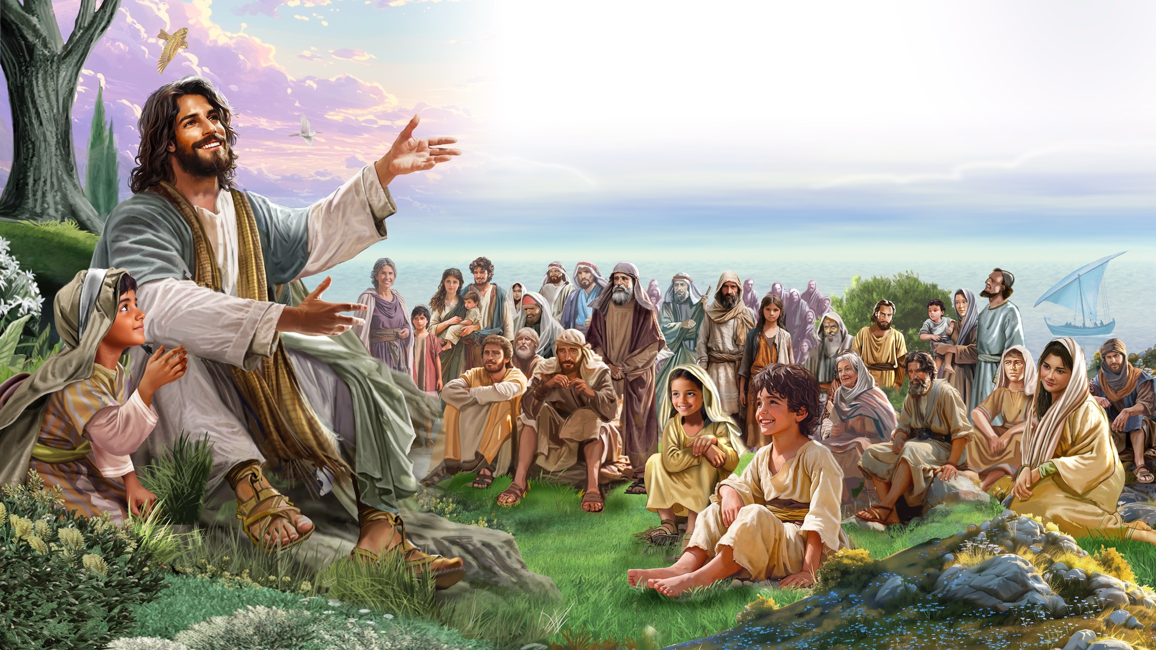
Illustration by Jo Card. Copyright © 2024 General Conference Corporation® of Seventh-day Adventists.

Slide 25
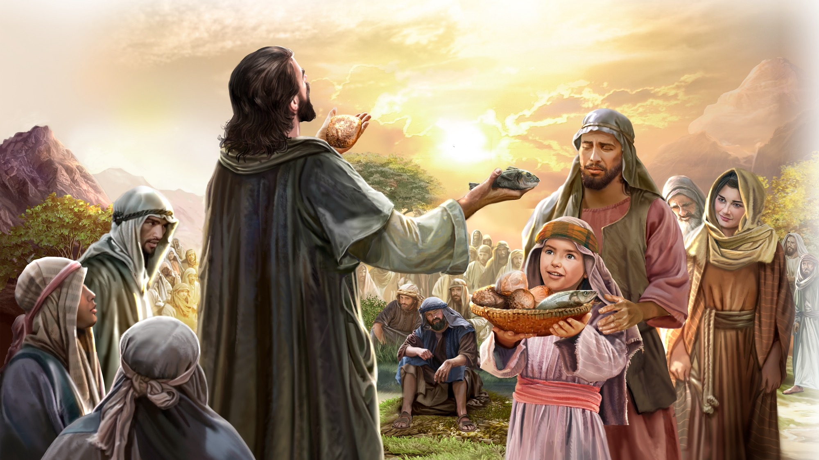
Illustration by Jo Card. Copyright © 2024 General Conference Corporation® of Seventh-day Adventists.

Slide 26
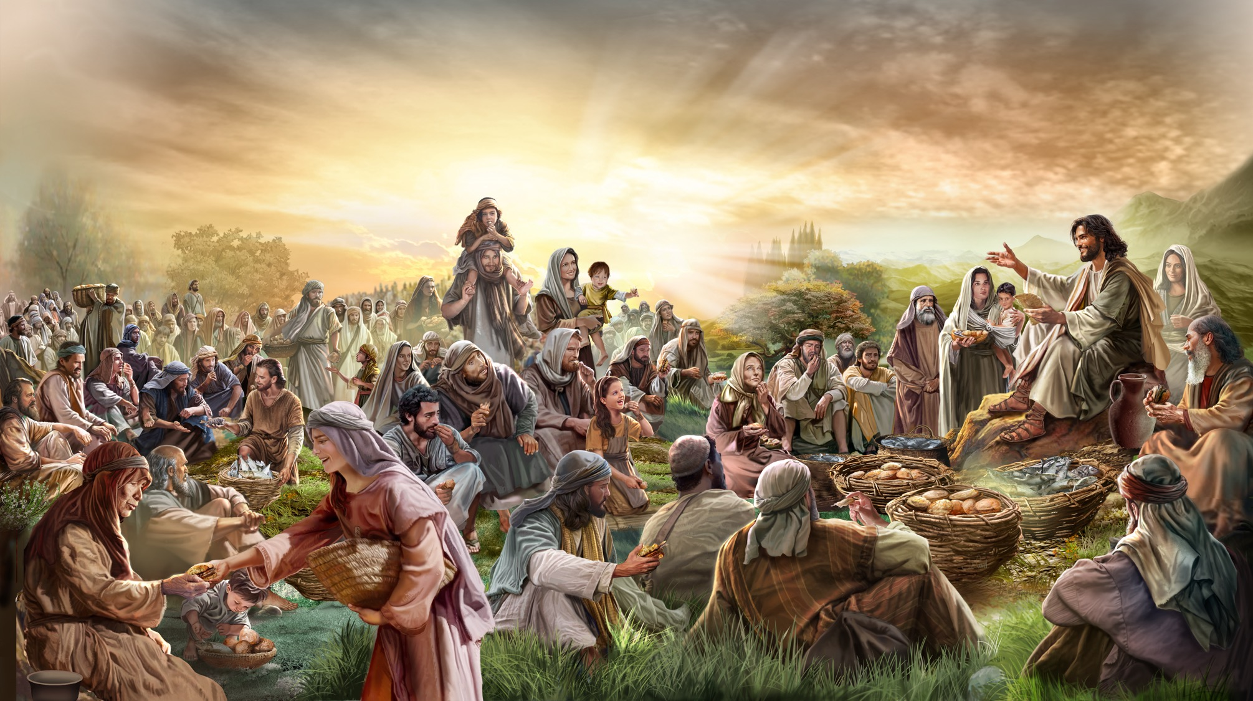
Illustration by Jo Card. Copyright © 2024 General Conference Corporation® of Seventh-day Adventists.

Slide 27
UNPACK
THE STORY

Slide 28
Thank You, Jesus
UNPACK THE STORY
Thank you, Jesus
For providing all my needs.
I want to give a little back
Of what you’ve given me.
Please bless our
Sabbath School offering.
May it bring You glory
And help others in need.
(Repeat above)
May it bring You glory
And help others in need.
"Thank You, Jesus" by Rosie Smith, copyright © 2024 General Conference Corporation® of Seventh-day Adventists.

Slide 29

CHARACTER CARDS

Slide 30
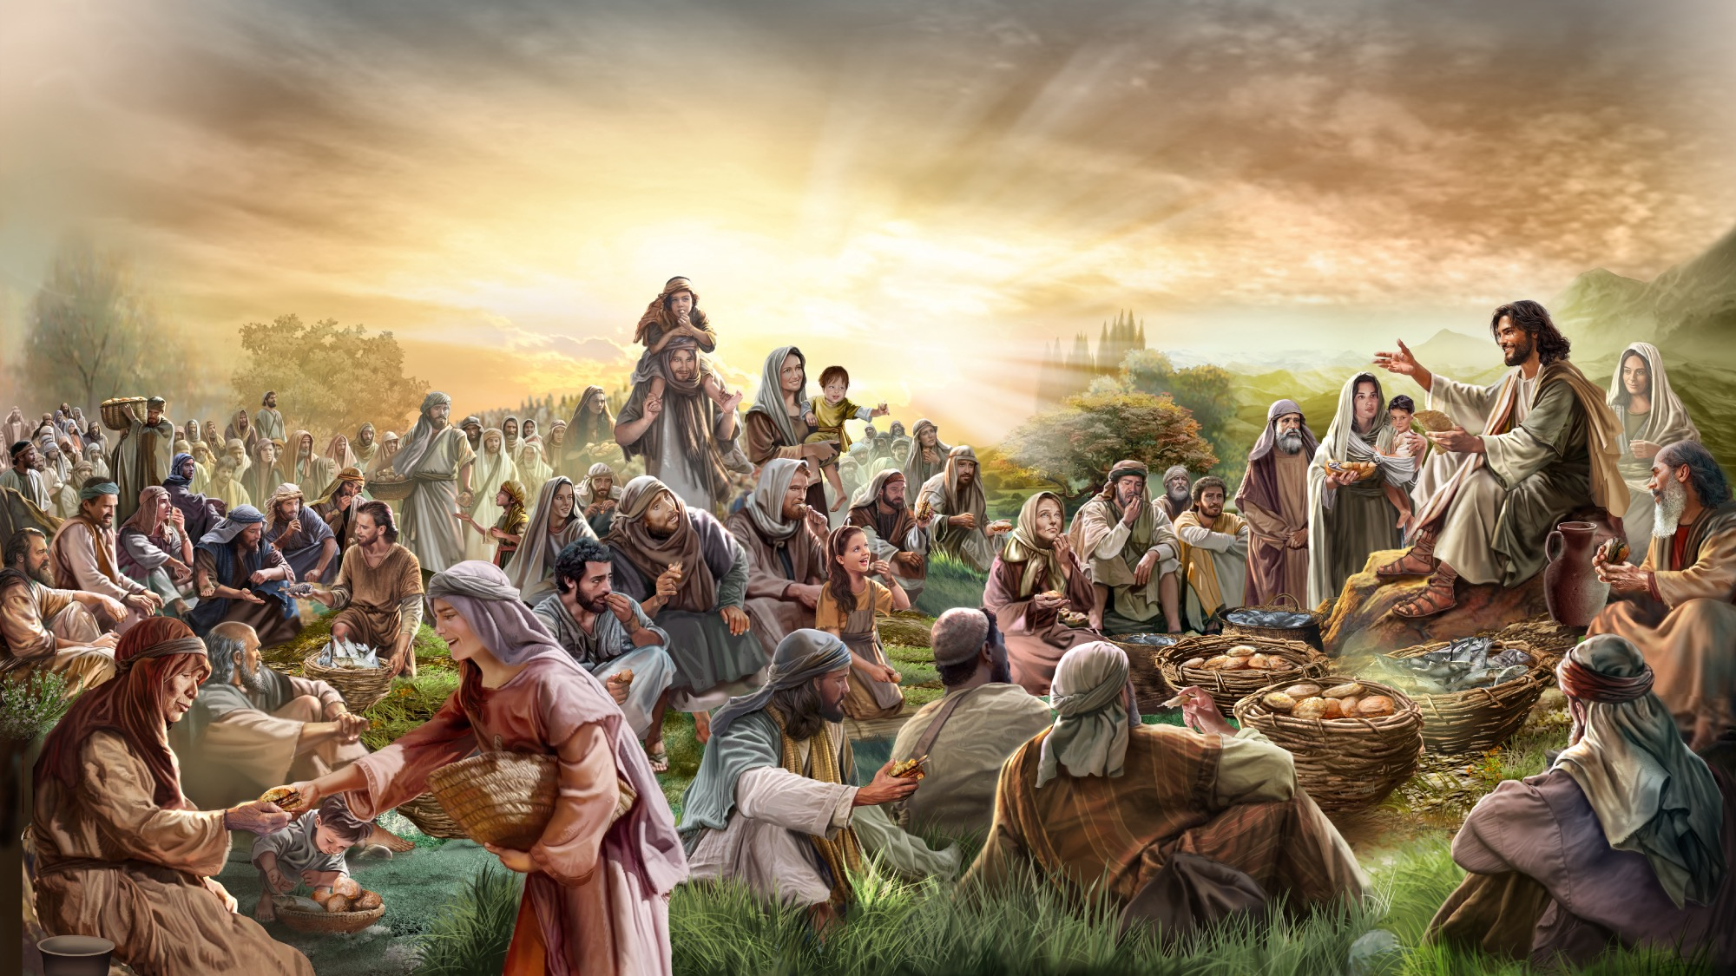
MEMORY VERSE
“And Jesus said to them, ‘I am the bread of life. He who comes to Me shall never hunger.’”
John 6:35

Slide 31
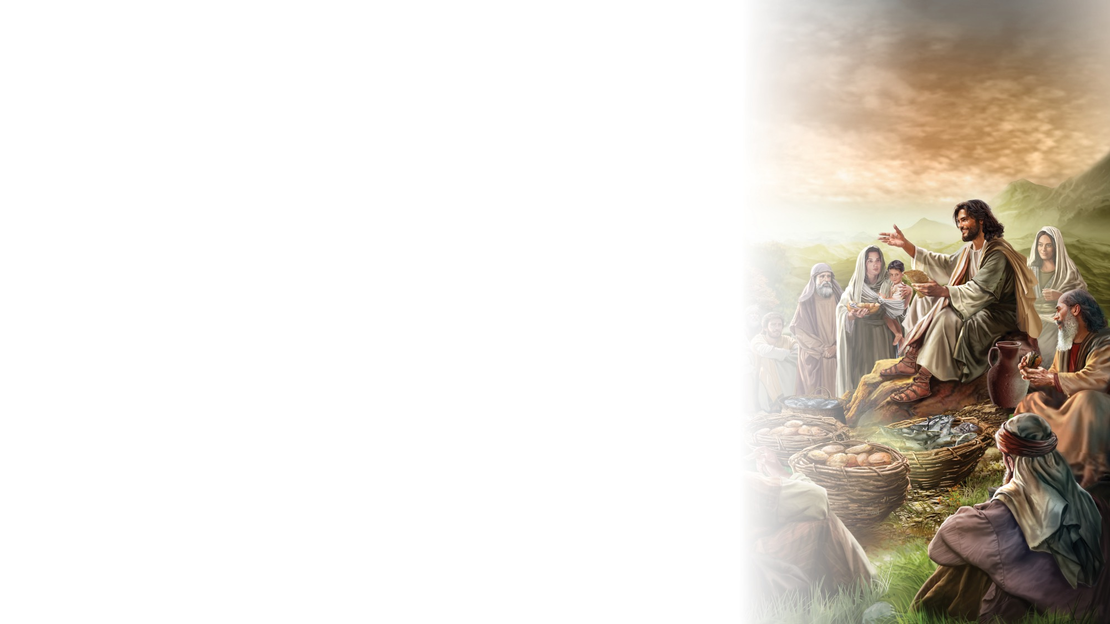
John 6:35
SCRIPTURE SONG
And Jesus said to them,
I am the bread of life.
He who comes to Me
Shall never hunger.
John chapter 6 verse 35.
(Repeat above)
And Jesus said to them,
I am the bread of life.
"John 6:35" music by Rosie Smith, copyright © 2026 General Conference Corporation® of Seventh-day Adventists.

Slide 32

NATURE
LESSON

Slide 33

CRAFT

Slide 34

MISSION
CHALLENGE

Slide 35
BIG IDEA
Jesus feeds me with His words and with food.

Slide 36

PRAYER
PRAYER

